Slide 1
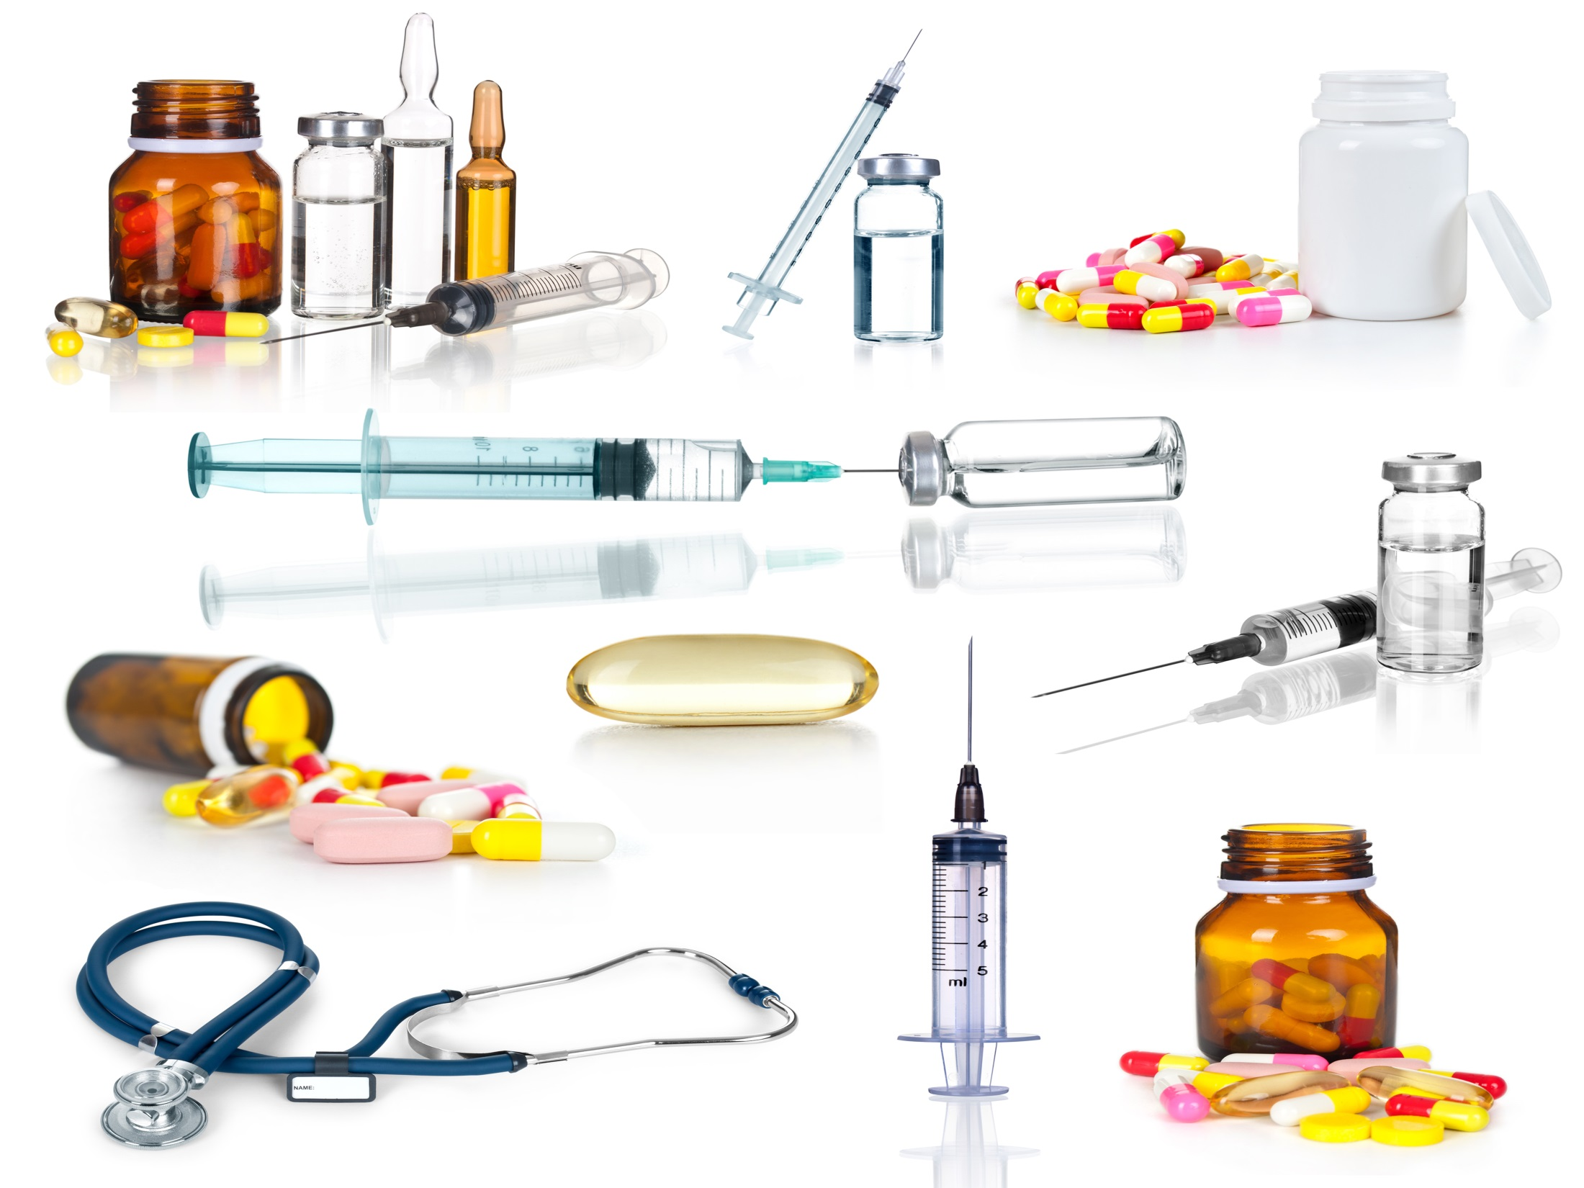
Improving access to effective solutions against COVID-19 pandemic
Mariângela Simão – 29 July 2020
Mariângela Simão - WHO

Slide 2
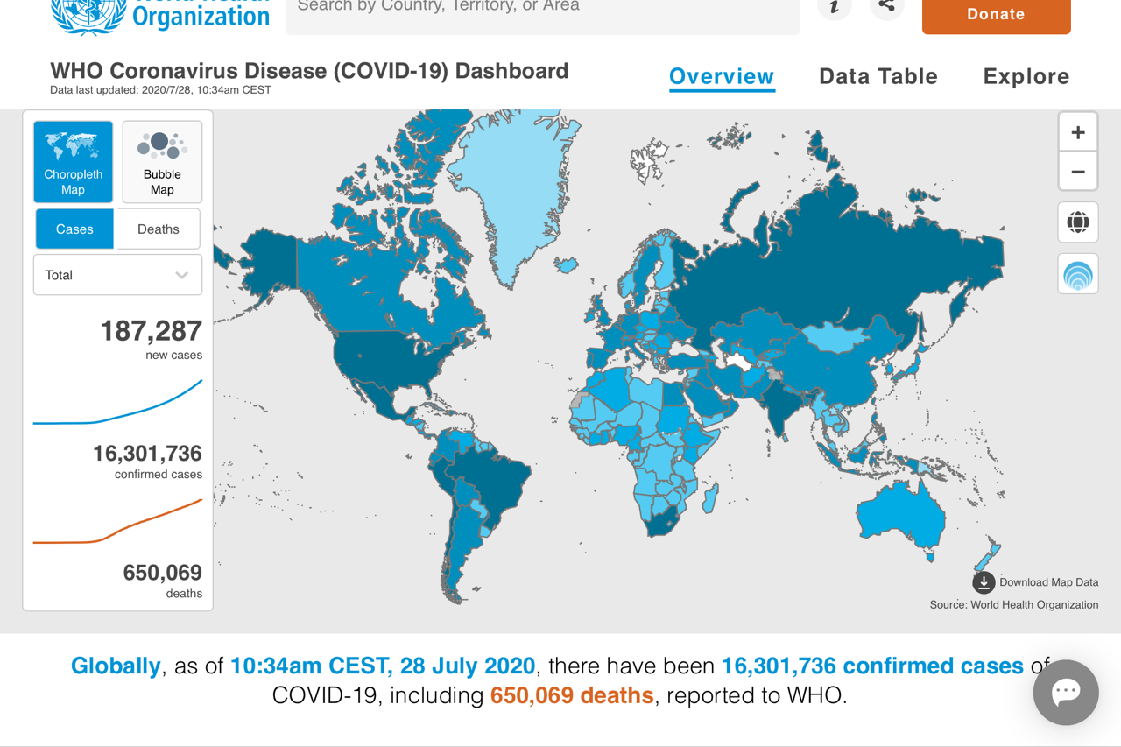

Slide 3
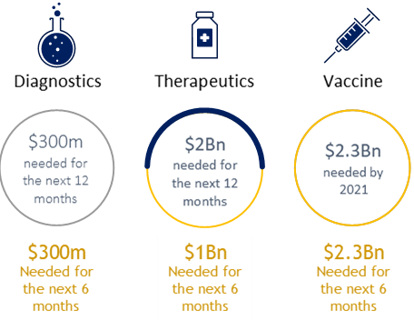
The Access to COVID Technologies (ACT-A) goal: reduce COVID19 mortality & severe disease through accelerated development, equitable allocation & scaled up delivery of…
Vaccines
Therapeutics
Diagnostics
2 billion doses by the end of 2021
245 million courses for populations in LMICs by mid-2021
500 million tests to LMICs by mid-2021
...thereby protecting health systems & restoring societies & economies

Slide 4







ACT-A leverages the best of international health in coordination with WHO
Support Hub
Vaccines
Therapeutics
Diagnostics
Coordination & Support
  Development & manufacturing
  Policy & allocation
  Procurement & delivery at scale
  Rapid assessment of candidates
  Market preparedness
  Deployment in all countries
  Costing & financing
  R&D
  Market readiness tools
  Supply
  Country preparedness
Support Hub
Cross-cutting
Access & Allocation
Support Hub
All Pillars
Norms & Standards
Regulatory/PQ
Policy & Technical guidance
Health Systems Connector
In discussion
  Country systems
  Protect frontline workers
  Clinical care
  Integrated data mgmt
  Financing
  Community-led responses
  Private sector
  Key supply elements supply chain
Co-conveners
4

Slide 5
A collaborative platform for vaccines – “COVAX”
With a fast-moving pandemic, no one is safe, unless everyone is safe
Today, historic scientific collaboration, with currently over 200 vaccine candidates in varying stages of development
Bilateral deals leave many countries behind
Unprecedented commitment from industry to work together in the interest of the global public good
Under a business as usual approach, it could take years to develop effective vaccines and decades to ensure they reach everyone that needs them
High risk of failure in vaccine development
US$375 billion lost to the global economy each month
Over 500,000 deaths and counting

Slide 6
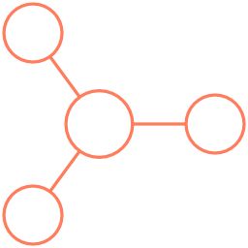

















Different vaccine technologies are under development
Example candidates
(not exhaustive)
Technology
Description
Protein
Purified or recombinant proteinaceous antigens from a pathogen to elicit immune response
Nucleic Acid
Genetically engineered plasmid containing the DNA sequence containing sequence for disease-specific antigen
Messenger RNA containing sequence for a disease-specific antigen
Viral vector
Chemically weakened viruses to carry DNA, containing sequence for disease-specific antigen, into human cells
Inactivated
Chemically “killed” virus or subunits of the virus grown under controlled conditions
Notes:
Vaccine characteristics affect deployment:
Immunogenicity (e.g. sub-optimal effect on elderly populations)
Safety profile (e.g. women of childbearing age)
Ability to scale-up manufacturing
Cold chain requirement (e.g. -70C)
…
One vaccine may be more suitable for a target group / country type than another
Vaccines are unlikely to be interchangeable

Slide 7
The Allocation Framework and Allocation Mechanism
Goal
Protect public health and minimize societal and economic impact by reducing COVID-19 mortality Equal allocation between LICs, LMICs, UMICs and HICs as we seek to reach 20% of the population
Priorities
Health and social care workers
All countries receive doses to cover 3% of their population
High-risk adults
All countries receive additional doses to cover a total of 20% of their population (in tranches)
Further priority groups
Countries receive doses to cover more than 20% of their population
1
2
3
Countries receive doses proportionally to their total population
Timing is based on country need, vulnerability and COVID-19 threat
Timing
A buffer will also be set aside for emergency deployment based on immediate needs

Slide 8
Addressing uncertainties – pooled mechanisms for access – the “COVAX Facility”
Three options
Implications
National access mechanism
Countries negotiate deals with manufacturers individually (e.g., lock into supply agreements locally)
High
Global access offers:
Opportunity to have fair access and allocation across countries
Access to a large number of manufacturers, offering ‘risk-pooling’ (e.g., less risk of having no supply if certain vaccine candidates fail, or do not cover all populations)
A
C
B
Grouped access mechanism
Countries form regional groups or blocks to negotiate supply agreements
Number of manufacturers accessed
B
Global access mechanism
Countries participate in a global mechanism to procure and access products – the COVAX Facility, managed by GAVI
A
C
Low
Single country
Region
Global
Number of countries

Slide 9
Therapeutics
WHO is tracking 1700 clinical trials globally
WHO Solidarity Trial
COVID-19 living map on ongoing research – info on studies per country, showing study design, disease severity in study participants and type of treatment
A living synthesis of study results - list of treatment comparisons, summary of evidence for comparison and detailed description of primary studies, including a risk of bias
The full landscape of experimental treatments currently under investigations by national health authorities around the world is available here
See also PAHO ongoing living update on potential therapeutics

Slide 10
ACT-A Therapeutics Partnership Workstream Structure
Therapeutics Partnership Leads: Paul Schreier (Wellcome, Co-Chair), Philippe Duneton (Unitaid, Co-Chair)
Process management: BCG
1
2
3
4
Rapid evidence assessment of candidates
Market preparedness
Adequate deployment in all countries
Costing / financing
(cross-cutting)
Description
Coordinate clinical trials portfolio, scientific direction and selection of candidates for development at scale
Facilitate market entry and supply at scale (inc. regulation, production capacity, pricing)
Ensure procurement, equitable distribution and delivery at scale and in all settings
Identify resource needs for successful delivery of partnership work
Workstream Lead
  Gates/Wellcome
  Unitaid
  Global Fund
  Unitaid
Initial thoughts on workstream membership
(Full list being developed)
  WHO;
  GHIT;
  Industry and
  others conducting R&D;
  R&D funders
  WHO PQ;
  CSOs;
  Market and access expertise;
  Industry associations;
  GHIT;
  Reps from workstreams 1,3,4
  Implementing partners;
  CSOs; communities;
  UNICEF;
  Unitaid;
  World Bank;
  WHO
  Reps from workstreams 1-3

Slide 11
Based on preliminary matrix placement, identified priorities by asset for each workstream
Preliminary –
Work in progress / Subject to change
Implications
WS1
Consider focus on accelerating confirmation of anticipated high health impact of novel antivirals and mAbs, pending no overlap in funding efforts
Consider accelerating evidence generation of repurposed antiviral combinations to improve health impact score
Health impact
Data in hand
Prelim. Signal
8
Dexamethasone
Hyper immune globulin
Monoclonal antibody cocktail
6
Convalescent plasma
EIDD-2801
Remdesivir
Sofosbuvir/daclatasvir
4
Nitazoxanide/ atazanavir/ritonavir
Tocilizumab
Colchicine
WS2
Focus at-risk market preparedness on mAbs and novel small molecules
2
Lopinavir/ritonavir
Hydroxychloroquine
Chloroquine
0
Ability to deliver at scale
WS3
Focus on procurement of Dexamethasone
Low
Med
High
Note: Initial X-axis (scaling ability) denoted High-Medium-Low; WS2 to conduct detailed analysis on promising candidates

Slide 12
Illustrative – Not exhaustive
Ability to deliver at scale: potential market interventions to pursue*
Relevant for:
Root causes for constraints
Potential market interventions
Need for anticipation¹
Novel candidates
Repurposed candidates
Intellectual property
  Identify and license other suppliers on a voluntary (e.g. MPP) basis
  Negotiate agreement with patent holder to waive exclusivity right
Regulatory status
  Provide support to developer to fill critical data needs for reg. approvals
  Provide support to navigate into expedited global reg. process
Manuf. complexity
  Implement tech transfer agreements
  Identify operational levers to optimize and simplify manufacturing process
Manuf.
costs
  Secure supply for raw materials through pooled procurement / tenders / etc.
  Incentivize supplier base expansion to generate increased competition / scale
Supply capacity
  Set up advanced purchase / market commitment
  Fund additional manufacturing capacity investments
Conflicting needs
  Expansion of capacity for COVID-19 indication
  Fund R&D investment for substitutes to other indications
Requires to launch intervention shortly before
Requires to launch intervention highly in advance
Highly relevant
Moderately relevant
Potential significant investment
1. Answers to the question: how long in advance do we need to launch this intervention?
* From UNITAID

Slide 13
ACT-A Dx Partnership– structure
Structure and objectives might evolve over time to maintain alignment with Rx/Vx partnerships
2
Dx Partnership Leads: Catharina Boehme (FIND), Peter Sands (Global Fund)
      Supply
LMIC testing capacity
      R&D of tests &
      digital tools
      Market shaping
Description
Match supply & demand in LMICs, Allocate procurement funding / supply
Linked to Supply Consortium
Enhance country capacity to increase the effectiveness of testing through targeted investments (incl. digital infrastructure)
Develop tests and digital tools against prioritized needs
Identify and link digital tools to testing strategies
Drive access to tests through evidence generation (incl. operational research), mfg scale-up (e.g., through domestic production, know-how sharing) and innovative delivery models
WG Leads
  (WHO)
  (GF)
  (ACDC)
  (PAHO)
  (BMGF)
  (Unitaid)
  (FIND)

Slide 14
Why do we need diagnostics?
ACT-A Dx co-leads – GFATM and FIND
Confirm pandemic is defeated
  Testing is essential at every stage of
  the pandemic response
  Effective diagnostics are essential
  to limit the spread of infection
  Many countries have shown that
  “test, trace and isolate” works
1st diagnosis
Test & Vaccinate
Surveillance
TTI
Test & Treat
Notes:
Testing is essential at every stage of the pandemic response from the first diagnosed patient to the last confirmed infection.
Until a vaccine has been developed and produced for global use, effective diagnostics are the most important medical technology available to limit the spread of COVID-19.
We know that aggressive testing – implemented as early as possible and sustained over time – is what helps to contain the virus. Many countries have shown that “test, trace and isolate” works.
ALSO
Conventional PCR testing is complex to perform, and most testing laboratories are in centralized locations, leading to long turnaround times.
Ideally testing would be inexpensive enough and simple enough to make it widely accessible to communities, allowing early, minimally symptomatic cases to be detected, interrupting transmission.
The only widely-available simple rapid tests detect antibodies only 2 to 4 weeks into illness, too late for clinical decision-making. As the number of people infected over time in the community rises, the specificity of Ab testing falls.

Slide 15
Barriers mean we cannot reach everyone who needs a test today
CURRENT TESTING STRATEGIES RELY ON
SYSTEMS & INFRASTRUCTURE
Complex, expensive, slow, laboratory-based, resource-intensive
SUPPLY SHORTAGES JEOPARDIZE ACCESS
Manufacturing capacity is not in place to rapidly scale up production of tests to meet global demand
RAPID DIAGNOSTIC TESTS NEED INNOVATION
Need faster, more accurate, affordable, easier to use tests
TESTING IN LMICs IS 10% OF WHAT IT IS IN HICS, <1% IN LICs
Notes:
ALSO
PCR only recommended assay for case confirmation.
Access limited, shortages common
Costs high, turnaround times too long
POC molecular tests either underperforming, unavailable, or unfamiliar (young technologies)
Touching on the regulatory process
Increasing use of serology tests for surveillance
Growing number of PCR labs: 2500 lab EQA in progress by WHO
Significant and diverse pipeline of new tests under development

Slide 16
What do we want to deliver in next 12 months?
Well-performing Ag RDTs & point-of-care molecular tests developed
R&D
Non-proprietary test result reader app and interoperability solution developed
All countries able to deploy affordable, quality POC tests
Market
Readiness
Regionalized production incl. in LMICs & mechanism set up to make RDTs affordable and available
Significant number of LMICs have been supported to put in place effective test, trace, isolate strategies
500m tests procured
Supply
Country policies and uptake in integrated
testing strategies driven in 50+ countries
Country
Preparedness
Disruption of core health services minimized
10,000 health care workers trained

Slide 17
WHO EUAL/EUL background
WHO Emergency Use Assessment and Listing (EUAL) mechanism developed in response to the 2014 - 2016 Ebola outbreak
Risk-based approach to expedite the availability of IVDs needed in public health emergency situations
It is intended to assist interested procurement agencies and Member States on the suitability for use of a specific IVD, based on a minimum set of available quality, safety, and performance data
EUL status is time-limited

Slide 18
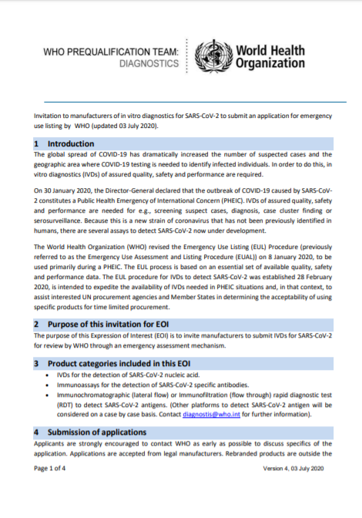
EUL in context of the COVID pandemic
30 Jan 2020: declaration of a PHEIC
28 Feb 2020: EOI for manufacturers of IVDs for the detection of SARS-CoV-2 nucleic acid under the EUL procedure
17 Apr 2020: WHO extended the invitation to manufacturers of RDTs intended for antibody detection
9 Jun 2020: WHO extended the invitation to manufacturers of RDTs intended for antigen detection
3 Jul 2020: WHO extended the invitation to manufacturers of immunoassays intended for antibody detection

Slide 19
Interest of manufacturers in the WHO EUL
Nucleic acid detection tests (NAT) & Ag
Serology (antibody detection)
PHEIC
NAT
Ag
PHEIC
RDT
ELISA
> 90 manufacturers (NAT)
signed LOA: 65
EU listed: 15
Failed/terminated: 6
100 manufacturers
active applications: 15
(7 dossiers received)
Antigen detection
9 manufacturers
active applications: 0
Notes:
update

Slide 20
Next steps
“ a cautious optimism”…

