Slide 1
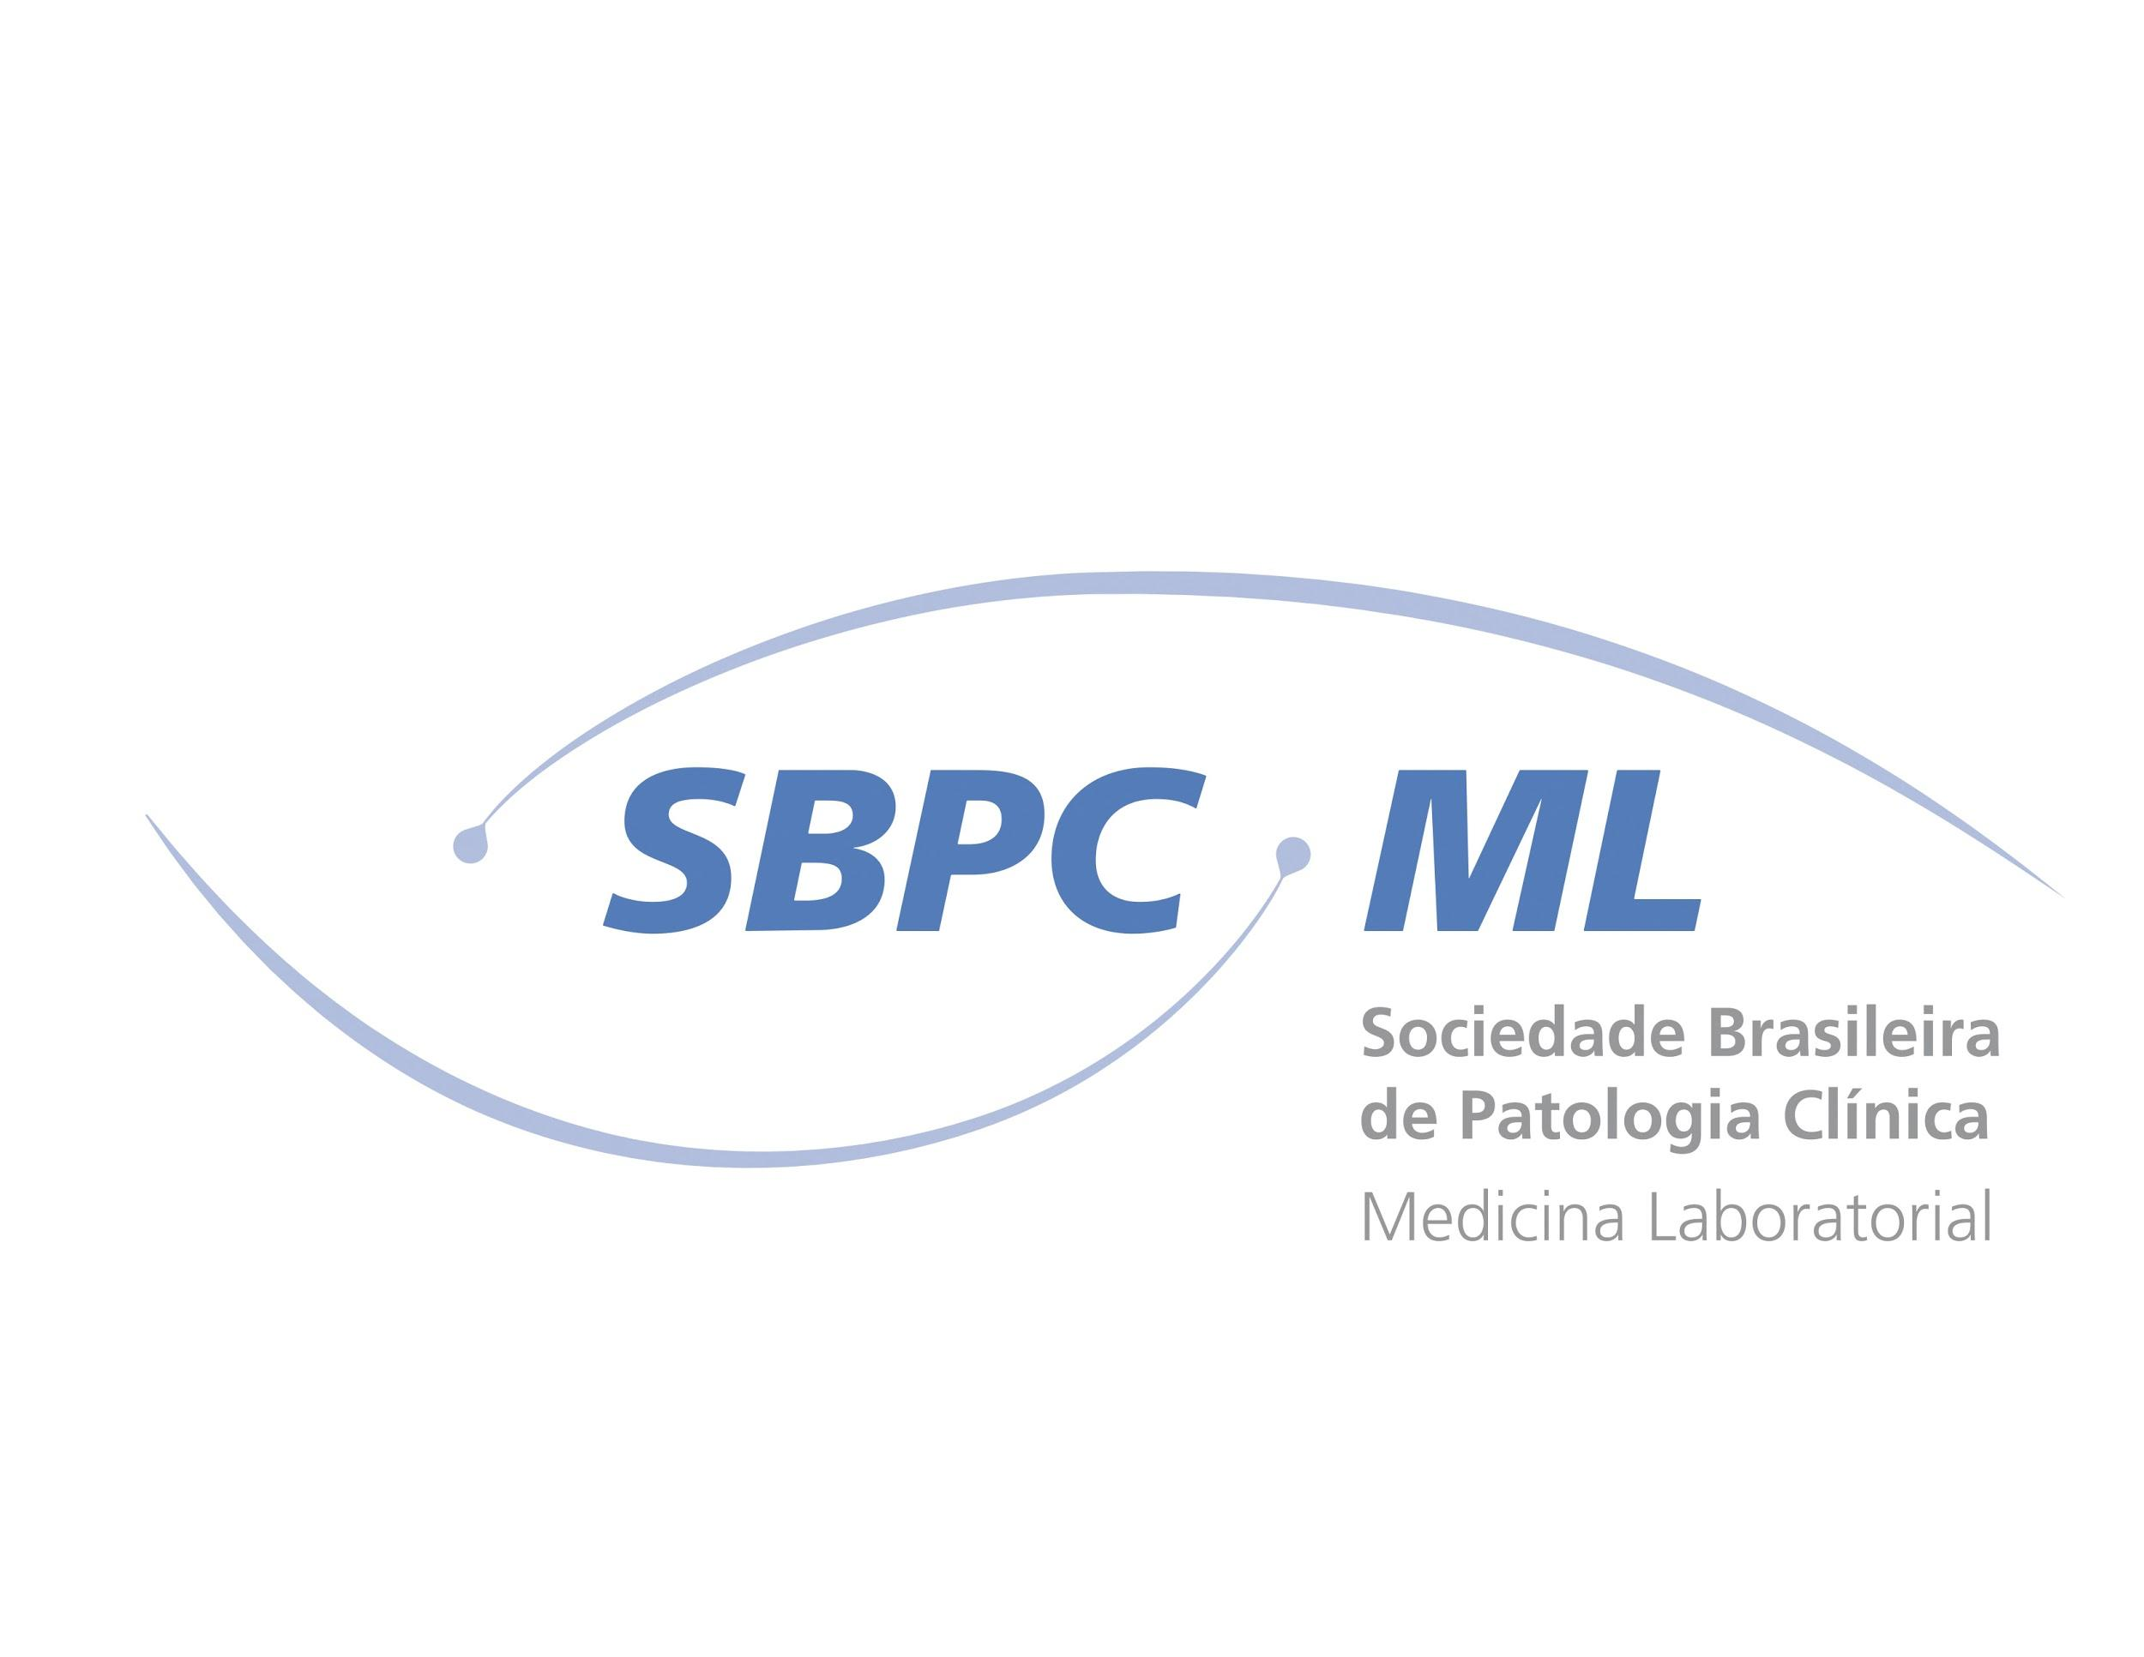
The role of diagnostics in the fight
against the pandemic COVID-19

Slide 2




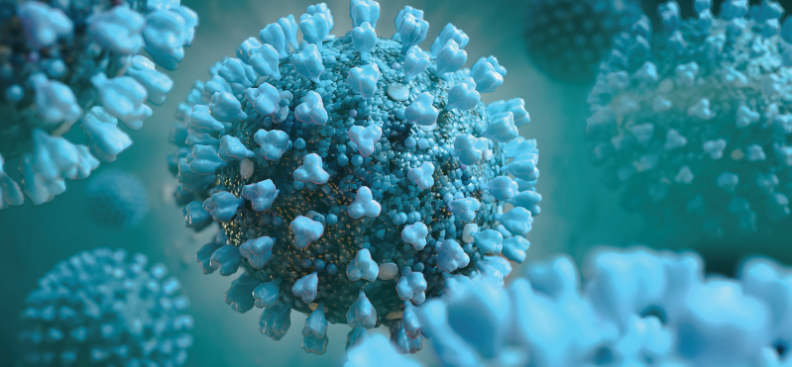



SARS-CoV-2 infection
COVID-19
Transmission
Person to person by respiratory secretions; indirectly through contaminated surfaces
Incubation
Range from 2 to 14 days
(median - 5 days)
Main symptoms
Fever, respiratory symptoms (cough), abdominal pain, diarrhea, vomiting, headache, myalgia
SARS-CoV-2
Clinical presentation
Asymptomatic infection or symptomatic disease ranging from mild to critical
Clinical progression
May cause severe respiratory disease, especially in patients over 65 and with comorbidities
1) Chen N et al. (2020). Lancet. 2020;395:507-13; (2) Holshue ML et al. (2020). N Engl J Med. 382:929-36; (3) Huang C et al. (2020). Lancet 395:497-506
(4) Wang D et al. (2020).. JAMA 323:1061-1069; (5) CDC. https://www.cdc.gov/coronavirus/2019-nCoV/hcp/clinical-criteria.html
(6) Wu JT et al (2020). Lancet 395:689-97;

Slide 3
SARS-CoV-2 infection
COVID-19

Slide 4
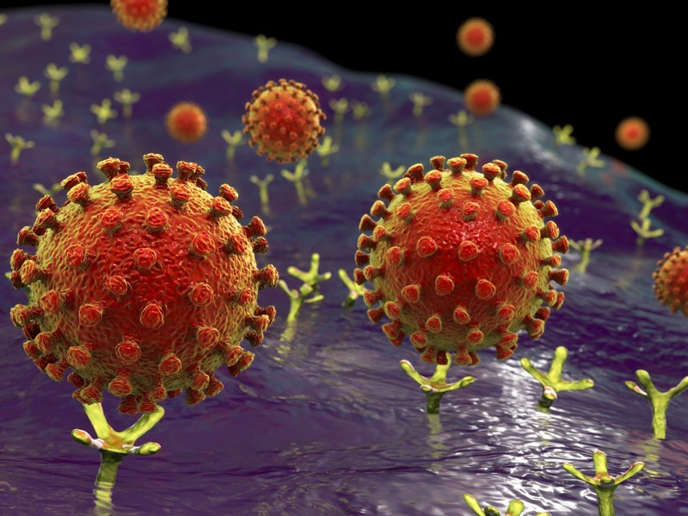
SARS-CoV-2 infection
COVID-19
ACE receptors
T. N. Starr et al. Preprint at bioRxiv http://doi.org/dz8r; 2020

Slide 5
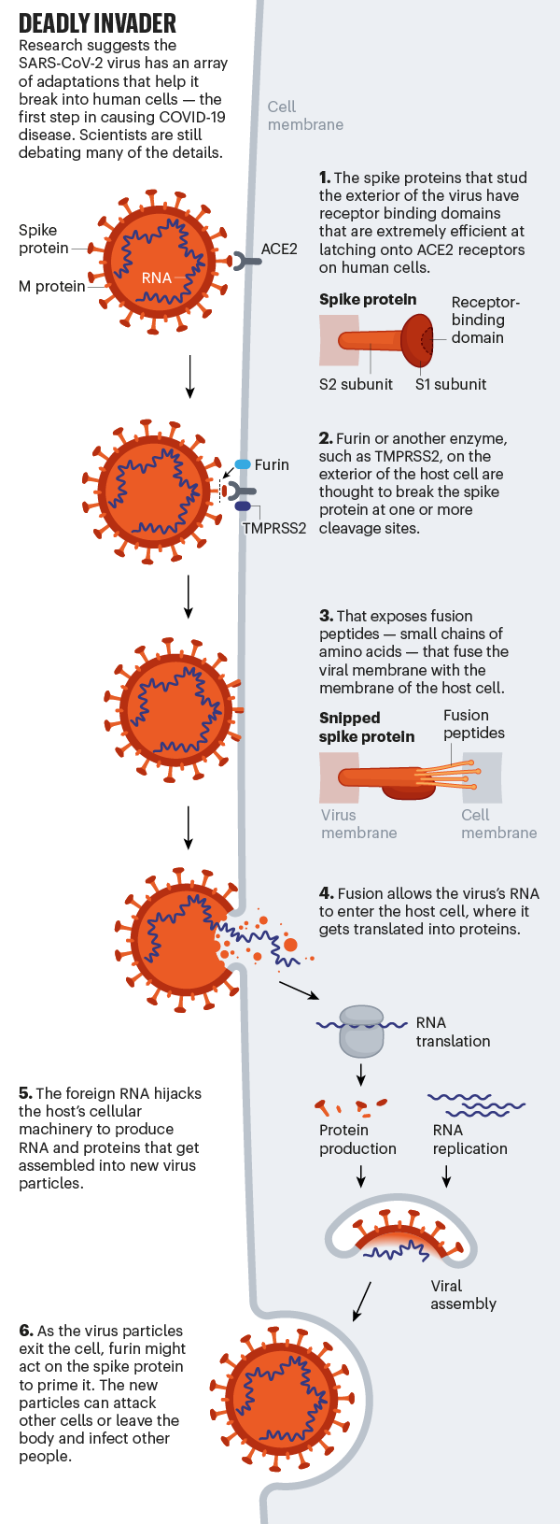
SARS-CoV-2 infection
COVID-19

Slide 6

Unmet medical needs

Slide 7
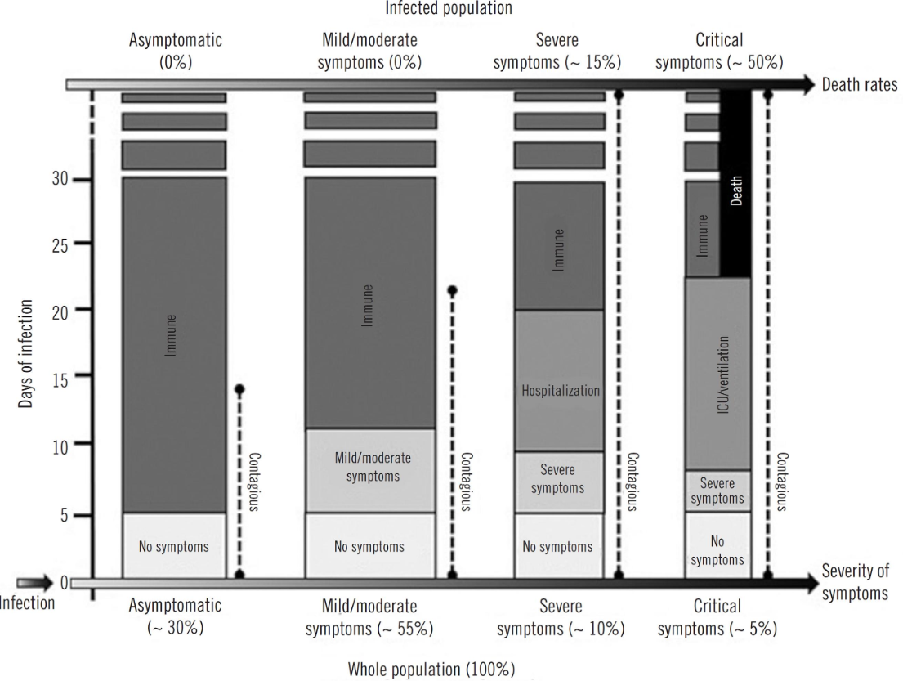
Diagnosis of COVID-19
Unmet medical needs
Clinical manifestations
Xavier, A. R. et al. COVID-19: clinical and laboratory manifestations in novel coronavirus infection. J. Bras. Patol. e Med. Lab. 1–9 (2020) doi:10.5935/1676-2444.20200049.

Slide 8
Who suffers more with COVID-19?
Elderly people
Diabetics
Hypertensive patients
1.7 billion people
Q. Jing et al. Lancet Inf. Dis. http://doi.org/dznw; 2020
A. Clark et al. Lancet Glob. Health http://doi.org/dzk9; 2020

Slide 9
Most patients are asymptomatic ...

Slide 10
Most patients are asymptomatic ...
50% don't get sick
Contactants
with patients
30% with respiratory symptoms
50% get sick
70% without respiratory symptoms
75% over 60 years old
P. Poletti et al. Preprint at https://arxiv.org/abs/2006.08471; 2020

Slide 11
Diagnosis of COVID-19
Unmet medical needs
Asymptomatic patients
Asymptomatic patients have a great potential to transmit SARS-CoV-2¹
Asymptomatic patients can transmit the virus for periods longer than 14 days¹
Patients with mild to moderate symptoms and asymptomatic patients may be diagnosed
with false negative results depending on the date of the test.
Oran, D. P. & Topol, E. J. Prevalence of Asymptomatic SARS-CoV-2 Infection. Ann. Intern. Med. (2020) doi:10.7326/M20-3012
Zhao J, Yuan Q, Wang H, et al. Antibody responses to SARS-CoV-2 in patients of novel coronavirus disease 2019 [published online ahead of print, 2020 Mar 28]. Clin Infect Dis. 2020.

Slide 12


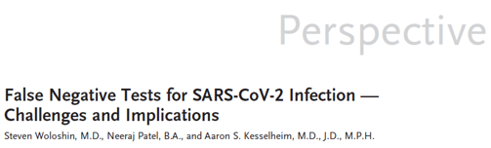
Diagnosis of COVID-19
Unmet medical needs
Patients with false negative or asymptomatic results
Virus transmission
Woloshin, S., Patel, N. & Kesselheim, A. S. False Negative Tests for SARS-CoV-2 Infection — Challenges and Implications. N. Engl. J. Med. (2020) doi:10.1056/NEJMp2015897.

Slide 13
Diagnosis of COVID-19
Unmet medical needs
Symptomatic patients
Similarity to common cold symptoms
Dyspnea and high fever are symptoms that define the main clinical difference between COVID-19
Similarity to other viral respiratory infections.
Xavier, A. R. et al. COVID-19: clinical and laboratory manifestations in novel coronavirus infection. J. Bras. Patol. e Med. Lab. 1–9 (2020) doi:10.5935/1676-2444.20200049.

Slide 14
Diagnosis of COVID-19
Unmet medical needs
Clinical manifestation
 | Serious and critical patient | Mild to moderate
Fever | 95% | 72%
Cough | 68% | 40%
Expectoration | 53% | 20%
Tachypnea | 11% | 4%
Dyspnea | 42% | 0%
Asthenia | 11% | 24%
Loss of appetite | 11% | 12%
Nausea | 11% | 0%
Vomiting | 5% | 0%
Rhinorrhea | 5% | 0%
Nasal obstruction | 0% | 4%
Pharyngeal dryness and pharyngalgia | 0% | 16%
Myalgia | 0% | 28%
Jin, A. et al. Clinical characteristics of patients diagnosed with COVID-19 in Beijing. Biosaf. Heal. 2, 104–111 (2020)..

Slide 15
Laboratory tests

Slide 16
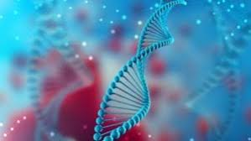
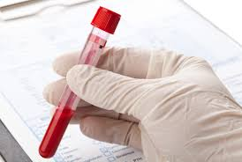
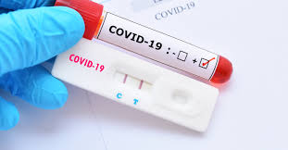
Diagnosis of COVID-19
Laboratory tests available
Molecular tests
RT-PCR
Serology
Antibodies.
POCT

Slide 17
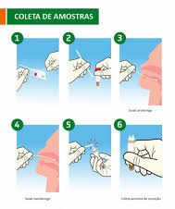
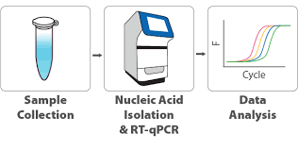
Diagnosis of COVID-19
“Gold standard”
Molecular biology test

Slide 18
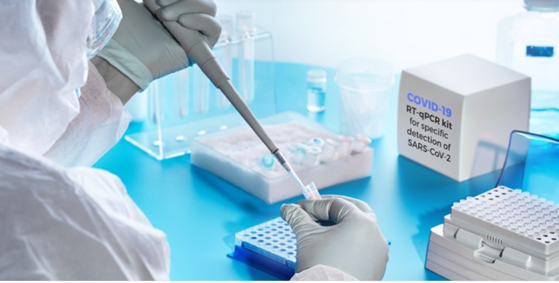
Diagnosis of COVID-19
“Gold standard”
PCR-RT is the most commonly used test and is performed with swab on¹:
- Nasopharynx
- Other upper respiratory tract samples
The PCR-RT test is considered highly specific and its positive result confirms the presence of the virus (“gold standard”) ²
Sethuraman, N., Jeremiah, S. S. & Ryo, A. Interpreting Diagnostic Tests for SARS-CoV-2. JAMA (2020) doi:10.1001/jama.2020.8259.
Maria, L., Vieira, F., Ii, E. E. & Iii, A. A. COVID-19 : laboratory diagnosis for clinicians . An updating article. 138, 259–266 (2020).

Slide 19
Diagnosis of COVID-19
Limitations of the PCR-RT test
Despite the high specificity of PCR-RT, its sensitivity may vary¹
- Depending on the day of material collection in relation to the onset of symptoms¹
Maximum sensitivity occurs between 8 to 14 days of symptom onset¹
Sensitivity of PCR-RT¹
 | 8-14 days | 15-39 days
PCR-RT | 54.0% | 45.5%
Zhao J, Yuan Q, Wang H, et al. Antibody responses to SARS-CoV-2 in patients of novel coronavirus disease 2019 [published online ahead of print, 2020 Mar 28]. Clin Infect Dis. 2020.

Slide 20
Diagnosis of COVID-19
Limitations of the PCR-RT test
Despite the high specificity of PCR-RT, its sensitivity may vary¹
- Depending on the day of material collection in relation to the onset of symptoms¹
Maximum sensitivity occurs between 8 to 14 days of symptom onset¹
- Variation of RNA viral sequences^{2,3}
Genetic diversity and rapid evolution of this new coronavirus have been observed in different studies ^{2,3}
- Depending on the pre-analytical aspects
Proper sampling and transport technique
These variations can lead to false-negative results with the PCR-RT ^{1,4}
Zhao J, Yuan Q, Wang H, et al. Antibody responses to SARS-CoV-2 in patients of novel coronavirus disease 2019 [published online ahead of print, 2020 Mar 28]. Clin Infect Dis. 2020.
Phan, T. Genetic diversity and evolution of SARS-CoV-2. Infect. Genet. Evol. J. Mol. Epidemiol. Evol. Genet. Infect. Dis. 81, 104260 (2020).
Shen, Z. et al. Genomic diversity of SARS-CoV-2 in Coronavirus Disease 2019 patients. Clin. Infect. Dis. an Off. Publ. Infect. Dis. Soc. Am. (2020) doi:10.1093/cid/ciaa203.
Shen, Z. et al. Genomic diversity of SARS-CoV-2 in Coronavirus Disease 2019 patients. Clin. Infect. Dis. an Off. Publ. Infect. Dis. Soc. Am. (2020) doi:10.1093/cid/ciaa203.

Slide 21
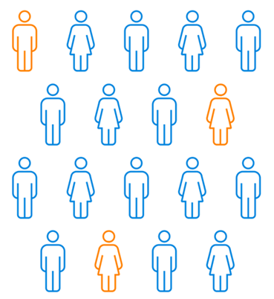
Diagnosis of COVID-19
Unmet medical needs
Situations in which the PCR-RT test is limited to detecting patients with COVID-19:
1) Symptomatic patients for Flu Syndrome or Severe Acute Respiratory Syndrome more than 14 days after symptom onset
2) Patients with previous contact with an infected patient for COVID-19.
Possibility of false-negative results with RT-PCR due to its sensitivity considerably decreasing 14 days after the onset of symptoms ¹
Zhao J, Yuan Q, Wang H, et al. Antibody responses to SARS-CoV-2 in patients of novel coronavirus disease 2019 [published online ahead of print, 2020 Mar 28]. Clin Infect Dis. 2020.

Slide 22
Diagnosis of COVID-19
Unmet medical needs
Situations in which the PCR-RT test is limited to detecting patients with COVID-19:
1) Symptomatic patients for Flu Syndrome or Severe Acute Respiratory Syndrome more than 14 days after symptom onset
2) Patients with previous contact with an infected patient for COVID-19.
Possibility of false-negative results¹ which would allow these individuals to not be isolated and to transmit the virus to other people ²
Zhao J, Yuan Q, Wang H, et al. Antibody responses to SARS-CoV-2 in patients of novel coronavirus disease 2019 [published online ahead of print, 2020 Mar 28]. Clin Infect Dis. 2020.

Slide 23
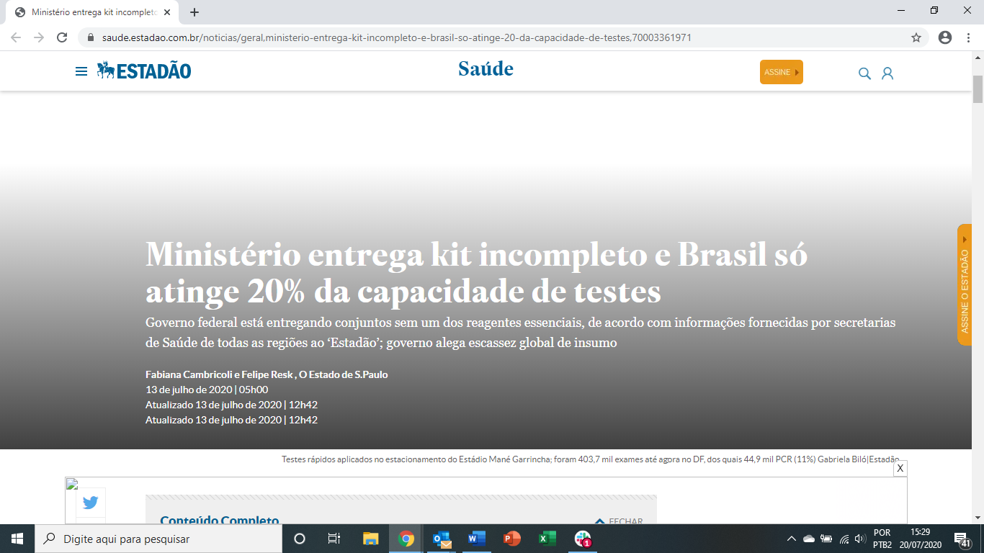
Diagnosis of COVID-19
Limitations of the PCR-RT test
Despite the high specificity of PCR-RT, access is still limited
Shortage in Brazil of reagents and laboratories using molecular biology techniques
https://saude.estadao.com.br/noticias/geral,ministerio-entrega-kit-incompleto-e-brasil-so-
atinge-20-da-capacidade-de-testes,70003361971

Slide 24
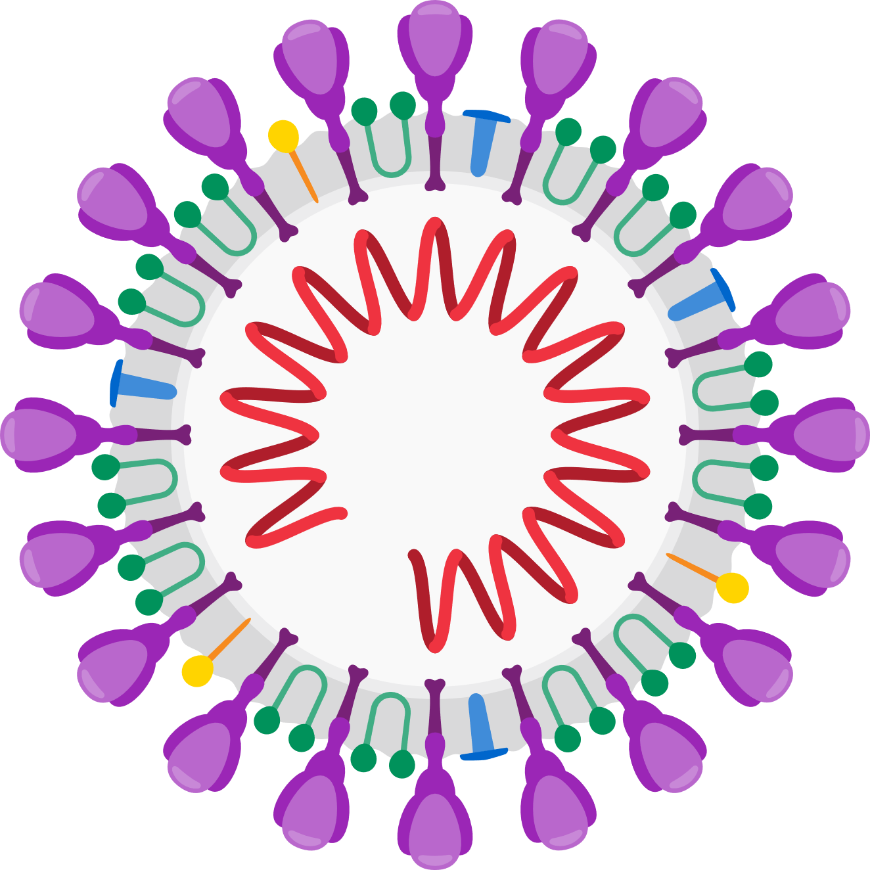

Antibodies to COVID-19
IgM and IgG
Antibodies are generated against the proteins Spike (S) and the nucleocapsid (N) ^{1,2}
IgM and IgG appear mainly at the same time, but IgG may increase earlier than IgM! ^{2,3}
Antibody levels are not directly correlated with clinical severity ²⁻⁴
Os níveis séricos de anticorpos não se correlacionaram diretamente com a gravidade clínica
Antibodies Anti-N
Antibodies IgG
Antibodies IgG
Antibodies. IgM
Antibodies IgM
10d*
leve ou grave
IgG premature ²
26% anti-N
57% anti-S
Antibodies. Anti-S
10d*
Okba NMA, Müller MA, Li W, Wang C, et al. medRxiv 2020.03.18.20038059;
To KKW et al. (2020). Lancet Infect Dis 2020; DOI:10.1016/ S1473-3099(20)30196-1
Wu F et al. medRxiv 2020.03.30.20047365; doi: https://doi.org/10.1101/2020.03.30.20047365; (4) Long et al. (2020). Nat Med. https://doi.org/10.1038/s41591-020-0897-1

Slide 25
Serological tests
How important is the diagnosis after the first week?
Late diagnosis (> 7 days)
Contact with infected patients
Common cold symptoms ¹
Not all patients have fever and dyspnea ¹
Asymptomatic individuals can transmit the virus for periods longer than 14 days ²
False-negative results with RT-PCR ³ make it possible for these individuals not to be isolated and to infect other individuals ⁴
Xavier, A. R. et al. COVID-19: clinical and laboratory manifestations in novel coronavirus infection. J. Bras. Patol. e Med. Lab. 1–9 (2020) doi:10.5935/1676-2444.20200049.
Oran, D. P. & Topol, E. J. Prevalence of Asymptomatic SARS-CoV-2 Infection. Ann. Intern. Med. (2020) doi:10.7326/M20-3012
Zhao J, Yuan Q, Wang H, et al. Antibody responses to SARS-CoV-2 in patients of novel coronavirus disease 2019 [published online ahead of print, 2020 Mar 28]. Clin Infect Dis. 2020.
Woloshin, S., Patel, N. & Kesselheim, A. S. False Negative Tests for SARS-CoV-2 Infection — Challenges and Implications. N. Engl. J. Med. (2020) doi:10.1056/NEJMp2015897

Slide 26
Serological tests
How important is the diagnosis after the first week?
Aid in the diagnosis and management of conditions caused by COVID-19
Evidence has shown a change in medical conduct with serological testing in the diagnosis and management of conditions caused by COVID-19. ¹
Detection of antibodies in patients who had pulmonary embolism and negative RT-CRP, limited the need for further investigation and reduced the anticoagulation period.
Negative serology has also helped to rule out COVID-19 as an agent for new conditions like hemophilia A and a variety of unusual dermatological presentations, eg "Covid's Fingers".
Differential diagnosis of other respiratory tract infections
Sweeney, N. et al. Clinical utility of targeted SARS-CoV-2 serology testing to aid the diagnosis and management of suspected missed, late or post-COVID-19 infection syndromes: results from a pilot service. medRxiv 2020.07.10.20150540 (2020) doi:10.1101/2020.07.10.20150540..

Slide 27
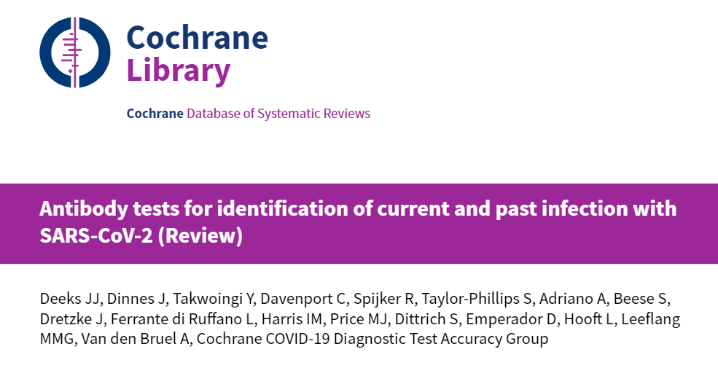
Serological tests
Recommendation for the use of serological tests
They conclude that serological tests may complement the diagnosis of COVID-19 in patients with more than 7 days of symptoms who have had a negative result for RT-CRP or who have not been tested ¹
Deeks, J. J. et al. Antibody tests for identification of current and past infection with SARS-CoV-2. Cochrane database Syst. Rev. 6, CD013652 (2020).

Slide 28
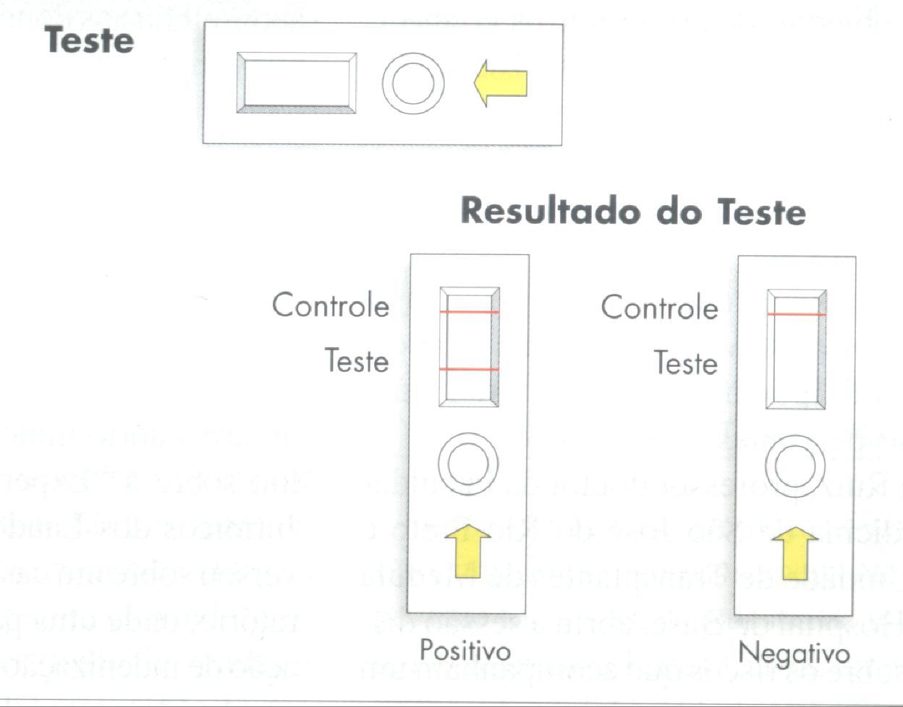
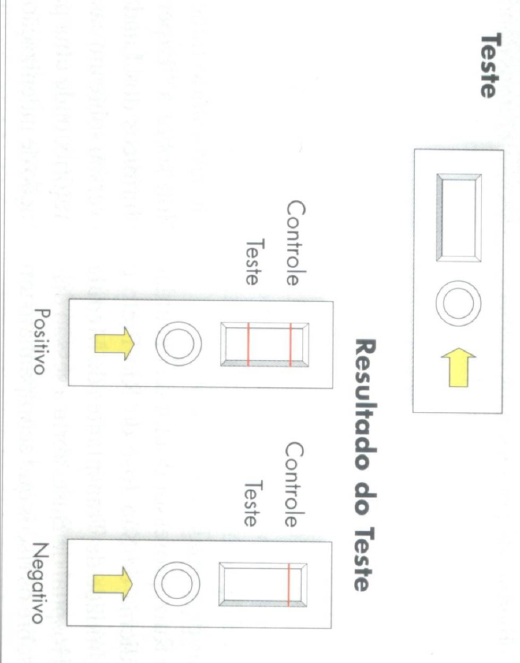
Diagnosis of COVID-19
Point-of-care test SarsCoV-2
Control
Test
Result
Positive
Test
Control
Test
Result
Negative

Slide 29
Diagnosis of COVID-19
Point-of-care test SarsCoV-2
Immunoassay
Princípio do método de ELISA competitivo (Créditos da Figura: Eloisa Comiran).

Slide 30
General aspects of Pandemic
Pandemia COVID-19
Epidemiological
Diagnostics
Treatment
Prevention
Vaccines
Findings
of cases
Cure
Medicines

Slide 31






Slide 32
Evolution of the program
PORTAL
Assessment of ALL technologies
Joining forces SBAC, ABRAMED
How to respond to the diagnostic challenge:
Sector entities
Large labs wrapping
Supplier involvement
Scientific knowledge
POCT – 4 labs
POCT – 1 lab
SBPC CBDL

Slide 33
Protocol
Common to all participants
Kits and Labs
PERFORMANCE Analysis
REPRODUCIBILITY analysis
Sensitivity
Specificity
Predictive value Pos and Neg,
Likelihood Ratio Pos and Neg
Diagnostic Probability Ratio
intra test
inter test

Slide 34
100 tests
Performance
Reprodicibility
Day 1
Day 2
Day 3
7-14 days
sintoms
20 tests
15-21 days
sintoms
20 tests
+ de 21days
sintoms
20 tests
Intra + inter
Inter
inter
60 tests
12 tests
12 tests
12 tests
Uses
3 results
9 tests
33 tests
93 tests
100-93= 7 “reserve” tests

Slide 35
Program performance
Anticorpo | Dias | Especificidade | Sensibilidade
IgA | 1 a 7 | 87,5% | 64,3%
 | >10 | 89,8% | 89,4%
 | >15 | 90,0% | 88,0%
 | Todos | 89,6% | 70,3%
IgG | 1 a 7 | 94,1% | 100,0%
 | >10 | 98,0% | 87,7%
 | 7 a 14 | 99,7% | 48,8%
 | 15 a 21 | 100,0% | 81,9%
 | >15 | 96,0% | 87,5%
 | >20 | 96,0% | 90,3%
 | >21 | 99,8% | 92,7%
 | Todos | 97,5% | 73,2%
IgM | 7 a 14 | 95,6% | 55,7%
 | 15 a 21 | 95,6% | 77,5%
 | >21 | 96,6% | 82,9%
 | Todos | 94,2% | 69,4%
IgG/ IgM | 7 a 14 | 96,4% | 79,4%
 | 15 a 21 | 96,4% | 100,0%
 | >21 | 96,4% | 98,1%
 | Todos | 96,4% | 90,3%

Slide 36
Some Numbers
12 labs
  Private and Public
25 suppliers
More than 25 tests evaluated
Over 6,500 samples analyzed
Until the date of 07/23/2020

Slide 37
Alvaro Pulchinelli, MD, PhD
diretorcientífico@sbpc.org.br
thank you!

