Slide 1
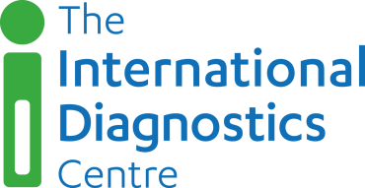
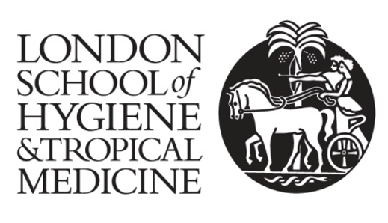
Rosanna W Peeling
Professor and Chair, Diagnostic Research
London School of Hygiene & Tropical Medicine
Director, International Diagnostics Centre
Diagnostics to support patient management
and public health measures
in the fight against COVID-19?

Slide 2
Diagnostics to support patient management

Slide 3
The right test for the right patient at the right time in the right setting
Diagnostic Tests | Target | Use Case | Optimal time for use post onset symptoms | Accuracy |  | Access- ibility | Affordability
 |  |  |  | Sens | Spec
Molecular: Lab POC | RNA | confirm infection | day 0-7 | **** | **** | √ √√ | $$$
Antigens: Lab POC | Proteins | confirm infection | day 0-10 | ** | *** | √√ √√√ | $$
Serology: Lab POC | Antibodies | exposure, surveillance | day 7-40 | *** | *** | √√ √√√ | $

Slide 4

What do we know about SARS-CoV-2 infectivity and RNA detection?
SARS-CoV-2 RNA can be detected several days before onset of symptoms and can remain detectable up to 25-50 days post onset of symptoms, esp. in patients not showing signs of recovery (To et al 2020, He et al 2020)
Viral RNA levels peak within the first 5 days post onset of symptoms and decrease slowly with rising antibody levels
RNA clearance is not always correlated with rising antibody levels, especially in those who were critically ill
A positive RNA result does not always imply that the patient is infectious: studies have shown that RNA tests remained positive for 1-2 weeks after viral replication has stopped (Wolfel et al 2020)
Ref. He X, Lau EHY, Wu P, et al. Nat Med 2020; 26(5): 672-5; To KK et al. Lancet Infect Dis 2020; 20(5): 565-74.
Wölfel R et al. Nature 2020; 581(7809): 465-9.

Slide 5
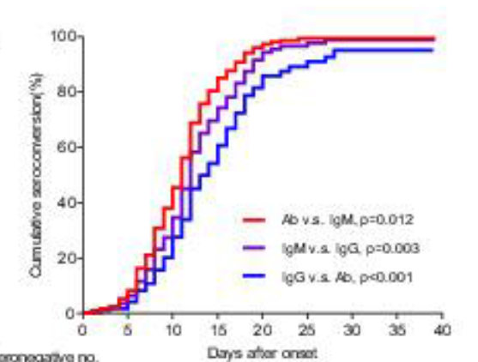
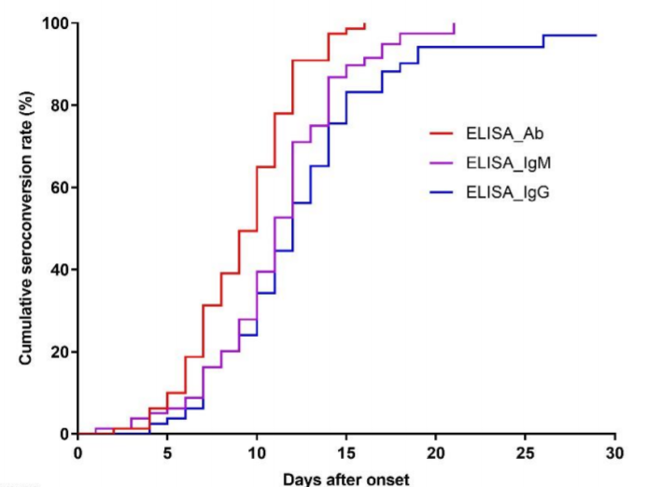
What do we know about the Immune Response to COVID-19?
Maturation of the immune response takes ~ 40 days; Seroconversion within 3 weeks
For COVID-19, mean time for seroconversion: total Ab= d. 11; IgM= d. 12; IgG: d. 14
Zhao et al CID 2020, N=173
Lou et al MedRxiv mar 2020, N=80

Slide 6
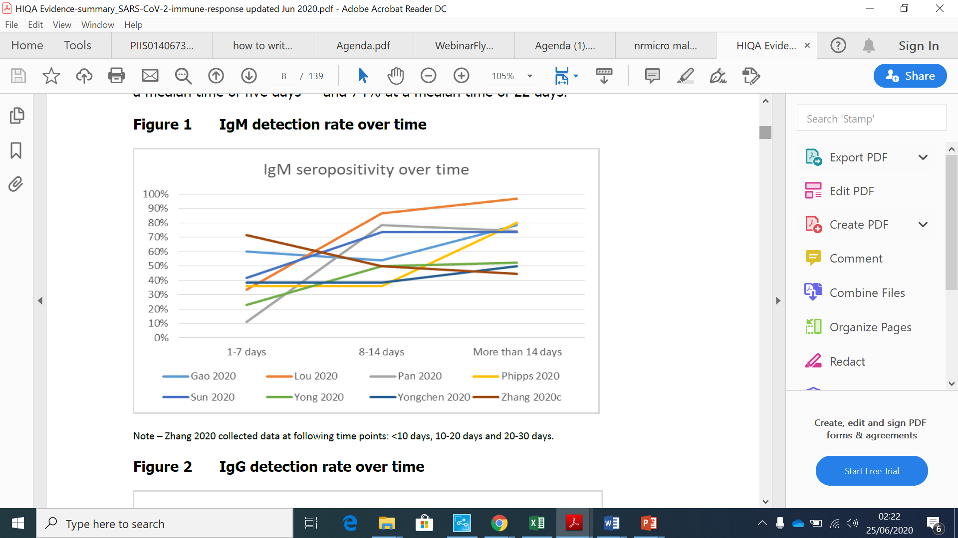
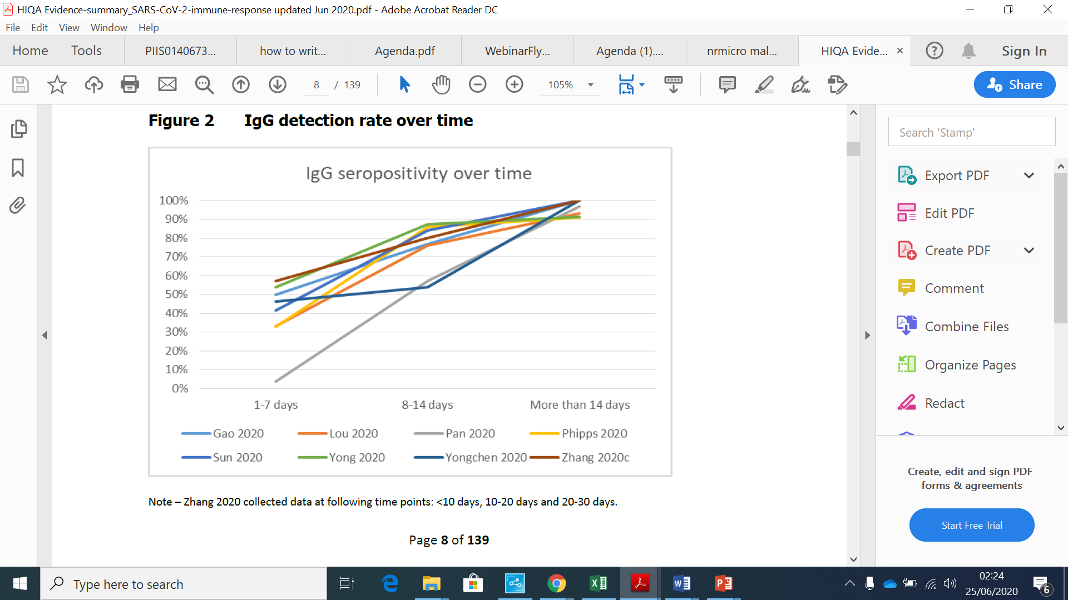
IgM and IgG Responses in Symptomatic Patients
Source: Health Information and Quality Authority, Ireland, 2020

Slide 7
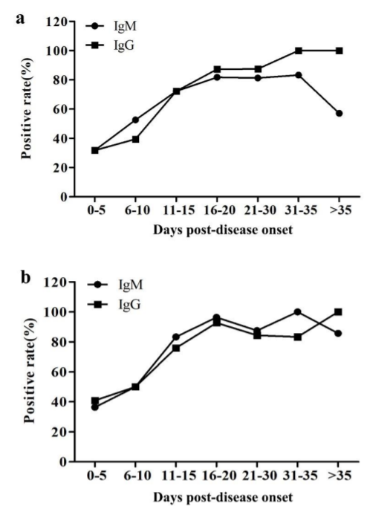
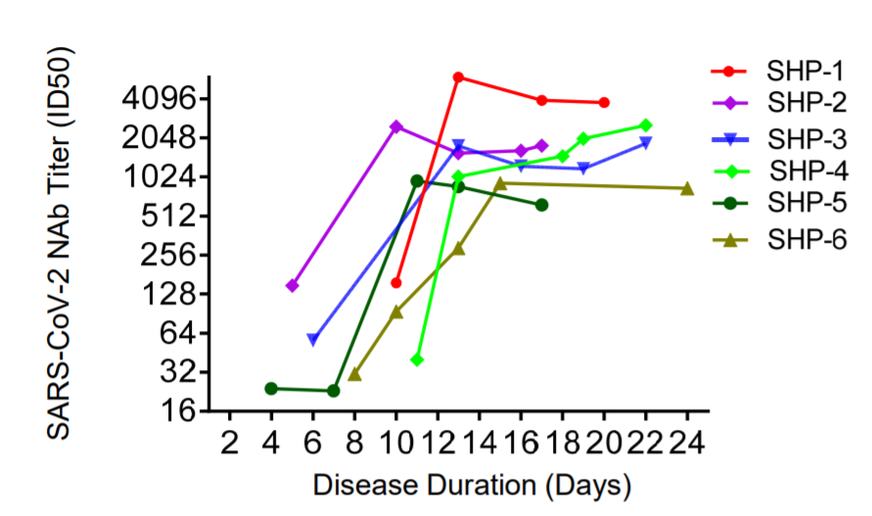
What do we know about neutralising antibody responses to COVID-19?
Antibodies against the Receptor Binding Domain (RBD)
of the Spike protein and the nucleocapsid protein (NP)
are correlated with neutralising activity
NP
SpikeP
Wu et al. MedRxiv mar 2020
Liu et al J Clin Microbiol Mar 2020, N=214

Slide 8
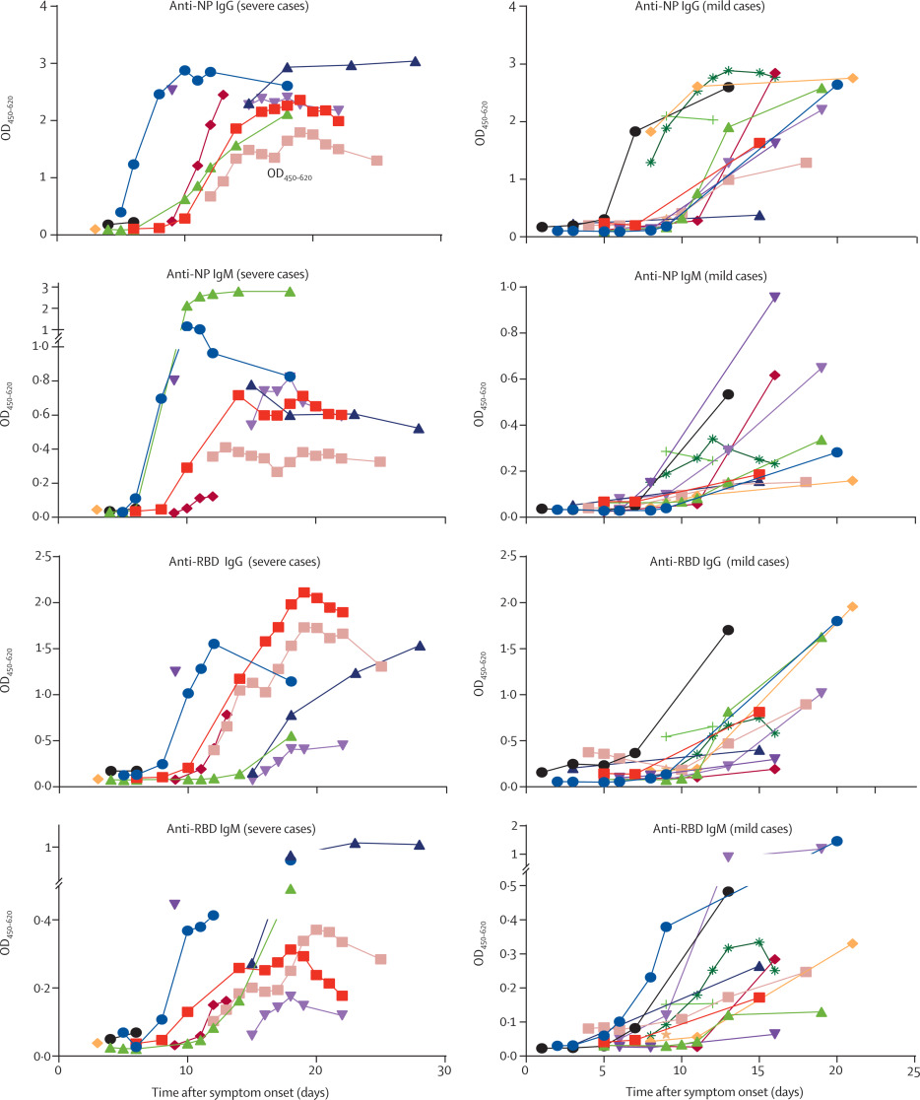
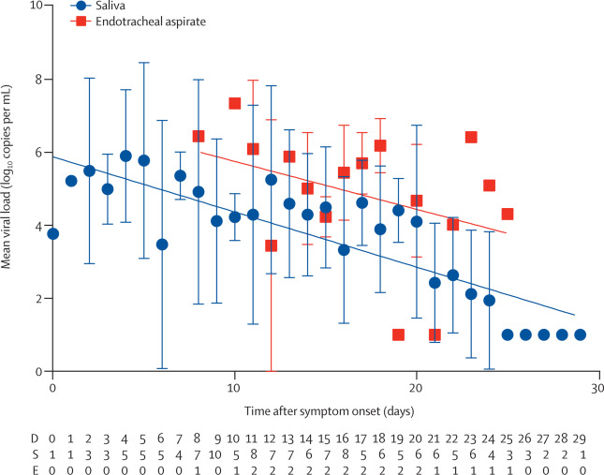
Neutralising antibody responses and viral load in hospitalised COVID-19 patients
Severe cases, N=10
Mild cases, N=13
Anti-NP IgG
Anti-NP IgM
Anti-RBD IgG
Anti-RBD IgM
To et al. Lancet Infect Dis Mar 2020

Slide 9
Combining RNA + Serology Tests Improves Sensitivity of COVID-19 Diagnosis
Patients typically present late as symptoms for a variety of reasons
A combination of molecular/antigen + serology tests may be useful
Days post onset of symptoms | # patients | RNA+ (%) | AB+ (%) | RNA +Ab (%)
1-7 | 94 | 66.7 | 38.3 | 78.7
8-14 | 135 | 54.0 | 89.6 | 97.0
15-39 | 90 | 45.5 | 100 | 100
Zhao et al. Antibody responses to SARS-CoV-2 in patients of novel corona virus disease. CID 2020
Hunsperger et al. Performance of dengue diagnostic tests in a single specimen diagnostic algorithm. JID. 2016;214:836–44.
Peeling et al. Reimagining the Future of the Diagnosis of Viral Infections. JID. 2016;214:828-9

Slide 10
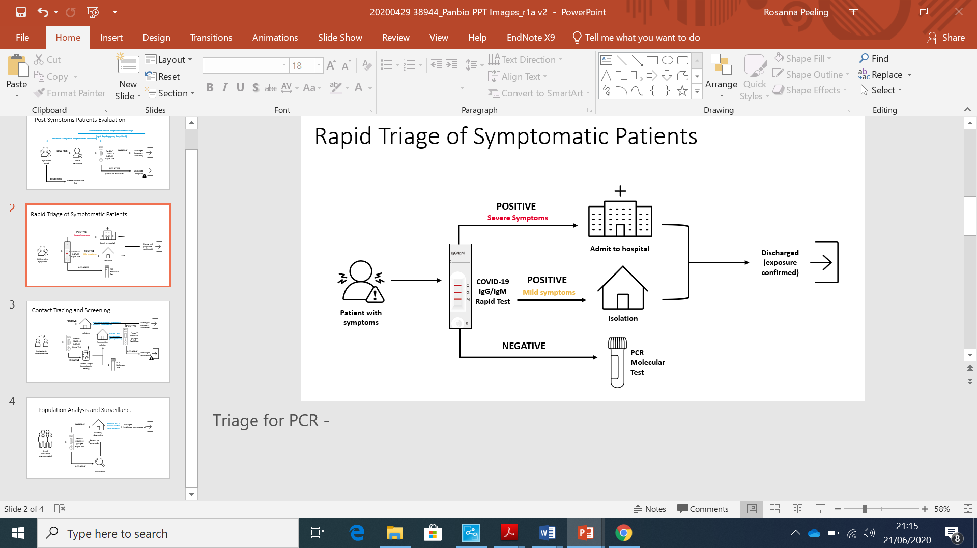
Rapid Triage of Suspect Cases in Peru
  Population: 32 million; limited molecular testing facilities and only 500 ICU beds
  A hotline and website ran by the MOH allow those who have symptoms to call/connect
(http://elbuho.pe/2020/04/coronavirus-peru-ultimas-noticias-y-casos/)
Results:
Rapid community triage of symptomatic individuals
Relieve backlog and waiting time for molecular testing
Prevent the health care system from being overwhelmed
Peeling et al. Serology testing in the COVID-19 pandemic response.
Lancet Infect Dis Published online: July 17, 2020

Slide 11
Discharge of Recovered COVID-19 cases from Hospital?
The optimal criteria for hospital discharge are 2 negative molecular tests over several days; but testing may be limited or not available
Some patients remain RNA positive despite having rising levels of IgM and IgG antibodies and there is uncertainty whether virus replication has stopped
Can serology tests be used as Immunity Passports?
COVID-19 patients can remain RNA positive despite rising levels of neutralising antibodies; high IgG levels are associated with severe disease
Protective immunity is not well understood
Barnes M et al. Challenges of Return to Work in an ongoing pandemic.
https://www.nejm.org/doi/pdf/10.1056/NEJMsr2019953?articleTools=true
http://documents.worldbank.org/curated/en/766471586360658318/How-Two-Tests-Can-Help-Contain-COVID-19-and-Revive-the-Economy

Slide 12
Diagnostics to support public health measures

Slide 13
Situation Analysis and Surveillance
Changing testing strategies as the pandemic unfolds has made it very difficult for countries to estimate the proportion of the population that has been infected.
Yet, this information is crucial for developing evidence-based strategies to introduce or adapt public health measures and travel restrictions
With as much as 44% of COVID-19 transmissions occurring when individuals are pre-symptomatic or asymptomatic, seroprevalence studies are the most useful means of:
  understanding the true population prevalence COVID-19
  monitoring trends over time
  mapping geographical distribution - identifying hotspots and at-risk populations needing special attention
  assessing the effectiveness of interventions

Slide 14
Diagnostics to support public health measures
With most countries still in some form of lockdown, and the prospect of a vaccine more than a year away, governments need a strategy to ease restrictions and revive the economy while ensuring that the country has:
  a healthy workforce for its hospitals and care home
  a means of monitoring safe environments for health-care facilities, including homes for the elderly
  workplaces and schools
  mass gatherings e.g. places of worship, sports events, concerts, festivals

Slide 15
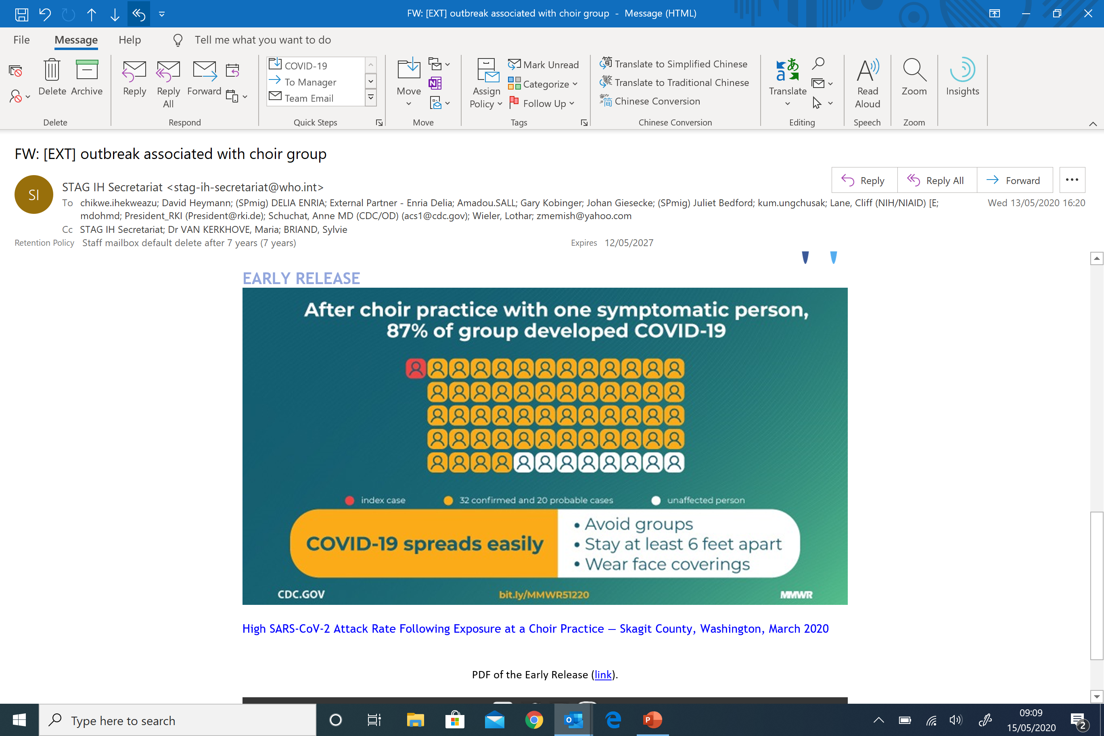
SARS Coronavirus2 Transmission, Skagit Country, Washington, March 2020
Courtesy of Prof David Heymann
Notes:
Transmission dynamics in African context are still unknown and should influence implementation

Slide 16
Translating COVID-19 outbreaks into successful virus suppression: the need for diagnostics
Shielding populations at risk – Antigen and antibody testing
Patient detection, rapid diagnosis and isolation with hospital surge capacity and PPE – Antigen testing
Contact tracing and isolation of contacts for 14 days – Antigen testing
Mitigation based on understanding of transmission patterns (mass gatherings) – Antigen and antibody testing
Epidemiological approach to forced physical distancing (intermittent “circuit breaker”) – Antigen and antibody testing
Community engagement and participation in outbreak containment and personal protection
courtesy of Prof David Heymann
Notes:
Transmission dynamics in African context are still unknown and should influence implementation

Slide 17
Health Care Worker Surveillance
Health care workers are a critical resource in the fight against the pandemic
“Regular screening of health-care workers by PCR is unlikely to be an effective means of workforce management until evidence-based algorithms to define target staff and frequency of testing are developed, and even then negative tests might offer a false sense of reassurance.”
“Supporting health-care workers in self-monitoring and self-care, providing them with easy access to diagnostics and medical and psychosocial support, and offering clear guidance for safe and timely transitioning back to work will strengthen patient care as a whole and could ultimately improve outcomes for many patients and health-care workers.”
Bielicki et al. Monitoring approaches for health-care workers during the
COVID-19 pandemic. Lancet Infect Dis published online July 23 2020

Slide 18
Summary
Diagnostics play an important part in the COVID-19 pandemic response
Need to ensure that the right test is used on the right patient in the right place at the right time
As antibodies appear early in infection, a combination of molecular/antigen + serology tests may improve case detection
Serology tests cannot be used to discharge of COVID-19 patients from hospital or as “Immunity passport” for health care workers to return to work
Serology tests are the most useful means of estimating the true extent of the pandemic, map its distributions, identify hotspots and at risk populations, monitor trends over time and assess effectiveness of interventions
Diagnostics can play a role in informing public health measures and easing restrictions while ensuring that schools, workplaces, mass gatherings are safe, but the sampling framework remains to be defined

Slide 19
LSHTM/IDC: David Heymann, Catherine Wedderburn, Debi Boeras, Noah Fongwen
Africa CDC: John Nkengasong, Yenew Kebede, Xiao-Chun Wang
Institut Pasteur Dakar: Amadou Sall
ASLM: Ndlovu Nqobile, Pascale Ondoa
FIND: Sergio Carmona, Jilian Jacks, Cassandra Kelly
Cayetano University, Peru: Patricia Garcia
Federal University Rio de Janeiro, Brazil: Amilcar Tanuri
Acknowledgement

